Slide 2
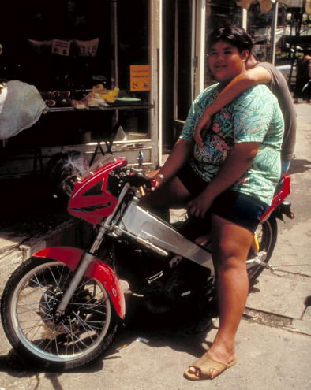
Obesity in Thailand

Slide 3
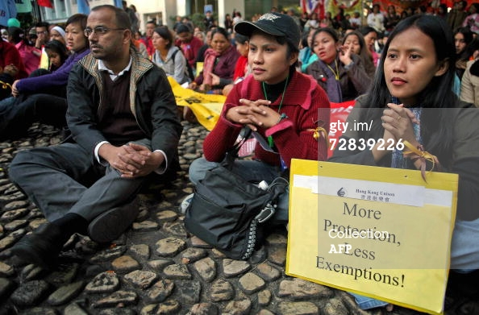
Defining Advocacy
Advocacy is the effort to
Change public perception
Influence policy decisions
Influence funding priorities
Advocacy includes people, communities or organizations that raise awareness about issues (problems or situations) and propose specific, achievable solutions
3
Notes:
Why we are talking about Advocacy – it is an overlooked first step
Just bec we know something is important to do – does not mean that everyone or a block of people feel the same way
Advocacy is a strategic activity to change public perception, influence policy decision, and even to influence funding priorities

Slide 4
6 important questions to ask yourself and the other advocates
1
What do we want to accomplish?
What is preventing it from being accomplished now?
Who or what can affect the necessary change?
What has been done before on this issue? What lessons were learned?
Who has fought this fight in the past? What can we learn from them?
How can we find out as much about the issue as possible?
2
3
4
5
6
Answering these questions will help you discover as much about the issue -past and present - as you can
5

Slide 5
7 Key Strategies for Advocacy
1
Target influential audiences that can affect change
Strategic communication to change public perception and influences policy decisions, including funding priorities
Raised awareness about the issue and solutions, specifically to targeted audiences
Use data and information to make your case about an issue
Develop messages and materials
Select appropriate information channels and media outlets
Enlist a credible spokesperson
2
3
4
5
6
7
4

Slide 6
Case Study Childhood Obesity
6
Notes:
Show video of Thai Childhood Obesity
Hand out case study

Slide 7
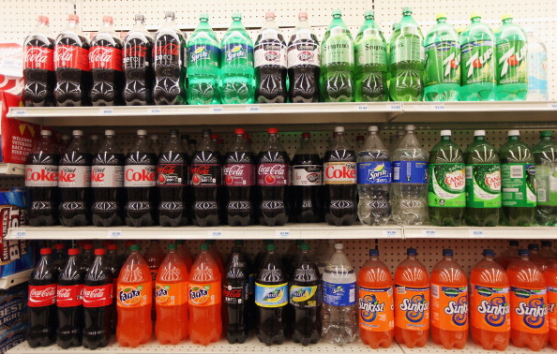
NYC Soda Ban

Slide 8
7 Key Strategies for Advocacy
1
Target influential audiences that can affect change
Strategic communication to change public perception and influences policy decisions, including funding priorities
Raised awareness about the issue and solutions, specifically to targeted audiences
Use data and information to make your case about an issue
Develop messages and materials
Select appropriate information channels and media outlets
Enlist a credible spokesperson
2
3
4
5
6
7
4

Slide 9
ADVOCACY PLAN
7

Slide 10
6 important questions to ask yourself and the other advocates
1
What do we want to accomplish?
What is preventing it from being accomplished now?
Who or what can affect the necessary change?
What has been done before on this issue? What lessons were learned?
Who has fought this fight in the past? What can we learn from them?
How can we find out as much about the issue as possible?
2
3
4
5
6
Answering these questions will help you discover as much about the issue -past and present - as you can
5

Slide 11
How can we collect evidence on the issue?
Call a meeting of the other like groups, including community or local partners.
Use your local library, resource center, school or university.
Talk to those most affected by the problem
Don’t assume you understand everything about the issue.
Meet with community leaders such as government officials, business leaders, educators, and religious leaders.
Read the newspaper and internet, listen to the radio, watch TV
Find out as much as you can about the opposite position
Identify a group or person who has already done research on the issue.
Read about the issue on the internet.
11

Slide 12
Influentials
12

Slide 13
Why start with Influentials?
13

Slide 14
Enlisting Influentials
Influentials are people, groups or organizations that share your interest in an important issue to you
Influentials may help you
OR
They may be the barrier that prevents change from happening
15

Slide 15
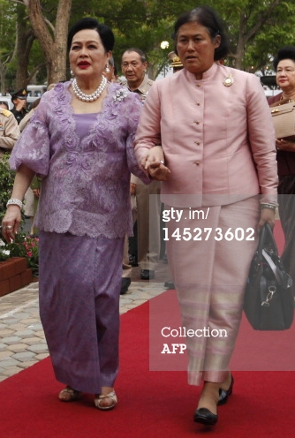
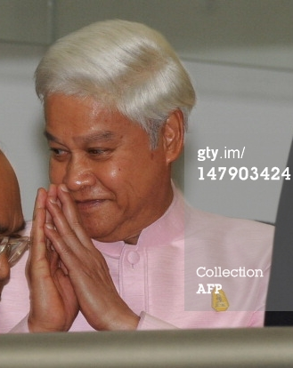
Enlist the people who have the influence to:
Take regulatory action
Take leadership action
Change policy
Influence public opinion
Change community practices
Change attitudes and norms
14

Slide 16
Exercise - Influential Analysis
3 Steps
1) Make a list. With your colleagues make a list of all the influentials you can think of
2) Prioritize your influentials. Who is seen as the leader or advocate for the issue or the advocate against
3) Understand the motivations of your influentials. Why will they support your advocacy project or cause? Why won’t they?
16
Notes:
Use the grid to do this exercise

Slide 17
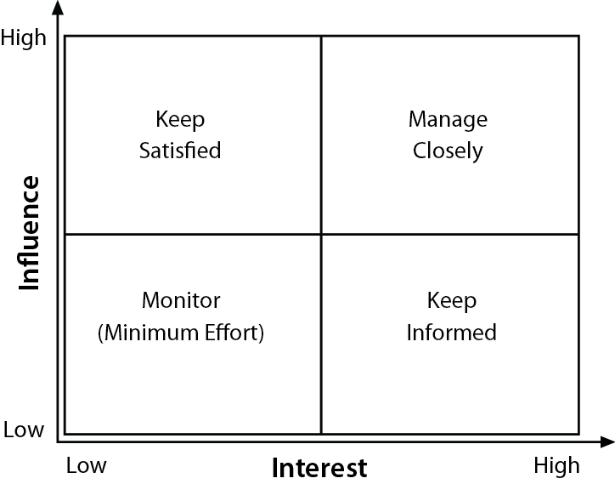
Prioritize your Influentials based on their interest and influence
High influence, less interest communicate enough to keep satisfied, but not so much they get bored
High influence, high interest fully engage and make the greatest effort to satisfy.
Keep
Satisfied
Manage
Closely
Monitor
(Minimum Effort)
Keep
Informed
Low influence, less interest monitor, but with minimum effort. Keep communication minimal
Low influence, high interest keep informed to ensure no major issues arise. Often helpful with details and goals of moving your cause forward.
18

Slide 18
Prioritize
With your own team name all the people who—
Are affected by your work
Have influence over your work
Have influence over your organization
Have interest in your success or
Have interest in your failure
17
Notes:
Slide 18

Slide 19
Understand your Influentials
You’ll need to know how best to engage them in your project or cause.
What is the financial or emotional interest they have in the outcome of your work.
What motivates them?
What information will they want from you?
What is the best way of communicating with them—phone calls, emails, or face-to-face meetings?
Communicate with them by using public forum — like news stories, print articles, mass media, earned media, PSAs, op-ed pieces.
Not as persuasive as face-to-face, but they create an enabling environment.
19
Notes:
replace

Slide 20
Understand your Influentials, contd.
In order to answer as many questions as possible, you will have to talk to your influential directly. Think of them as a primary audience.
If you can’t get access to the influential directly, talk to those who work with the influential. This usually means speaking to a staff person, an assistant, or an advisor. Think of them as a secondary audience. They are often the key to getting the attention of the influential.
Call a community meeting, for example a town hall meeting, and invite as many staff, assistants, advisors, media and influentials as you can. Though the influentials may be too busy to attend, their staff, assistants, advisor, or reporter may attend and report your message back to the influential.
Once you get to know more about your influentials, you may want to place them on your influential/interest grid as a reminder of how much you will need to engage them.
20

Slide 21
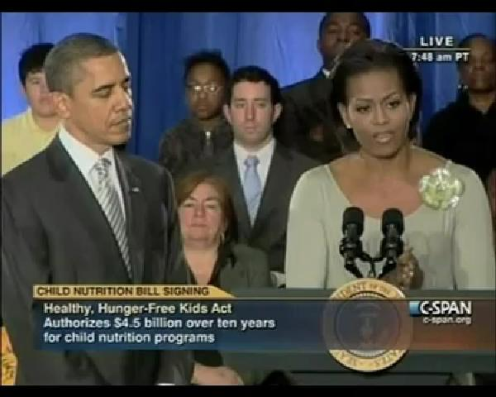
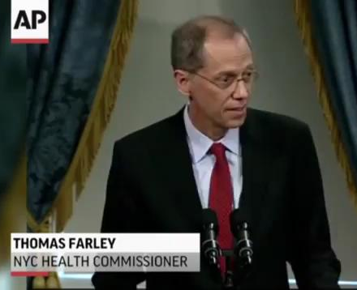
Influentials Video
13

Slide 22
Why start with Influentials?
Having others on board helps provides safety for advocacy and builds group support
There is strength in numbers and it’s nice to know you are not going at it alone
Diverse groups can capitalize on each other’s strengths
Diverse partnerships demonstrate and communicate to policy makers, opinion leaders and the public at large that the issue is so important that a wide range of interests have come together to promote change
Starting with partners means the burden of time; staff, funds and other resources can be shared from the beginning of your advocacy efforts
You can divide responsibilities among many, rather than just one or two. This helps prevent against burnout
21

Slide 23
Audiences
23

Slide 24
Who is the audience?
Advocacy requires that you reach out to both primary and secondary audiences.
Primary audiences on the local, state, national and global levels may include: decision makers, law makers, regulators and enforcers.
But, you must also reach those that influence the primary audiences, including the public, voters, the media, staff, religious leaders, families and friends. These are your secondary audiences.
24

Slide 25
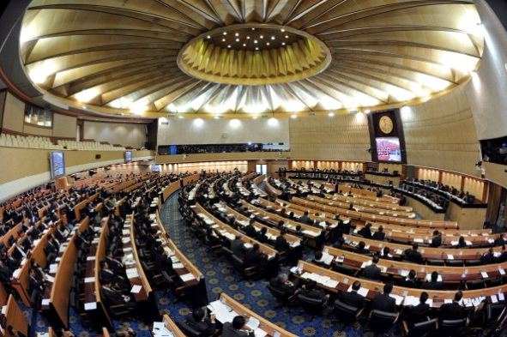
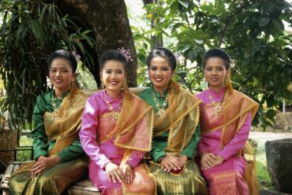
Segmenting Your Audience
Segmenting a specific target audience is important because you can’t speak to everyone in a population.
Different people respond to different messages.
The idea is to slice your audience into a distinct group or segment, but one still big enough to significantly further your goal.
Then your message can “speak” right to that segment.
25

Slide 26
Look at ways to group your audiences
Shared perceptions
Parents who think their children exercise for at least 1 hour at school every day
Demographics
Children 6-12 at public schools
Psychology
Mothers who feel guilty and that it is their fault that their children are overweight
Shared Benefit
PMs: Re-election, Happy constituents
+
29

Slide 27
Start with the believers first
Start with those you think share your position and are supportive.
Who may be receptive to your cause or issue?
Then move on to those more difficult to convince and change.
26

Slide 28
Consider what your audience “wants” not just “needs.”
Though we gather evidence on what people need, it’s also important to ask what they want.
Some will want a benefit
audience member may ask, “what’s in this for me?”
Some will want approval
from their friends, neighbors, boss or doctor
Others will want a way around a barrier
for example, “I want to eat more fresh fruit, but my local store only carries candy and snacks”
27

Slide 29
Most Audiences Embrace Easy & Fun
28

Slide 30
Who are the audiences?
29

Slide 31
Messages
30

Slide 32
There are two components to every message
Component #1 State what you want to change Component #2 State what you want the audience to do
Change + Action = Message
31

Slide 33
Messaging Should Be
Factual – substantiate information with accurate and reputable statistics and data
Understood by your audience – simple language and short sentences increases understanding
Know your audience - adjust to accommodate literacy levels
Call to Action – realistic specifics an audience should be able to do
Agreed upon behaviors – what do you want people to do and how to do it
Benefit(s) of doing this behavior
31

Slide 34
How to Reach the Audience
Face-to-face short meeting with a decision-maker to discuss the issue.
Briefing documents, presentations, fact sheets, editorials in the newspaper, radio discussion, or TV interview.
Conferences
33

Slide 35
Developing Messages
Is our message easy to understand?
Is the language we used appropriate for each audience(s)?
Does it respect cultural and social norms? This is very important if developing messages for audiences who live in a different culture than you.
Is the message truthful? Will it be perceived as truthful?
Is the message based on evidence?
Is the message and what it is asking of people realistic?
Did we test the message with members of the target audience(s)?
32

Slide 36
Launch of Let’s Move Campaign
13

Slide 37
Social Media
34

Slide 38
Non-traditional outlets and channels
Digital Activism
Social media and other new technologies
- Hashtags
- Twitter
- Facebook
- mAdvocacy includes cell phones, smart phones, pads and tablets
- YouTube
- Blogs
- Build a website around your advocacy
Guerilla tactics
- Occupy movements
35

Slide 39
Spokesperson
37

Slide 40
Finding and Preparing a Spokesperson
Do they communicate well?
Are they credible and trustworthy to your primary and secondary audiences?
Are they well rehearsed?
How many spokespersons should we have?
38

Slide 41
Do they communicate well?
1.
Everything communicates
Visual: 55%
Body language, eye contact, clothes, props
Voice: 38%
Pace, pitch, projection, pauses
Verbal: 7%
Content
Job of media is to get the story
Job of spokesperson is to tell your story, your way

Slide 42
Are they credible and trustworthy to your audiences?
2.
Known and recognized
Expert or authority in their field
Excellent communication style
Visual and Voice
Project easy, assured air of informality and confidence
Easy to Swallow Messages
Believable
Addresses audiences concerns
Doesn’t go against audience perceptions of life (reality or not)

Slide 43
Are they well rehearsed?
3.
Know key messages inside and out
Understand the secondary and primary audiences
Regularly review media to understand current thinking around the issue
Thought through possible questions
Practiced moving from question to key message (bridging)
Have practiced in front of a camera (or at least a mirror and/or audience)

Slide 44
How many spokespersons should we have?
4.
One “personality” but could be several people
Traditional media
Steer interviews and field policy/strategy questions from the media
Easiest to stick to one or few persons; you can’t avoid Visual and Voice differences on TV or the radio
Social media
Start conversations, steer conversations and field detail questions with everyone
Easier and necessary to have more than one spokesperson portraying the same tone and style
Accidental spokespersons

Slide 45
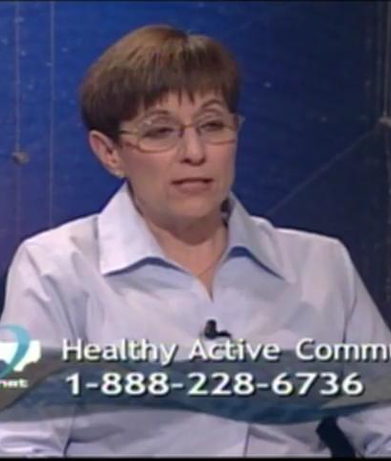
Spokespeople
39

Slide 46
Monitoring and Evaluation
40

Slide 47
Monitoring, Evaluating and Refining
Monitoring and evaluating your advocacy work is the best way to determine if your activities are making a difference.
Design your monitoring and evaluation of activities BEFORE your advocacy activities are launched.
It’s important to monitor the process of your activities as they occur. You need to know whether your advocacy activities are making a difference. Part of your activities may be working, while others may not.
41

Slide 48
Monitoring vs. Evaluation
Monitoring
Are we doing what we said we would do?
Are we doing it with quality, effectiveness and efficiency?
Continuous process
Internal tool
Evaluation
Did we achieve our objectives?
With what results/impact?
Usually at set time periods
Internal and external tool

Slide 49
Use Advocacy Objectives to Monitor and Evaluate
Objectives do not need to be the end goal of policy change may be a benchmark along the way
Advocacy Objectives
Build coalition from 10 to 50 local organizations
Increase awareness of high-fat content of school lunches among mothers from 15% to 80%
Increase local media coverage of obesity issue from 3 print and 1 broadcast stories per month to 10 print and 5 broadcast stories per month
Get a “healthier public school lunches” policy proposal accepted for debate at the annual lawmakers’ state education hearing

Slide 50
Why do we Monitor?
To understand if our program seems to be working
Are we winning advocates?
Is our coalition growing?
Is public opinion changing?
Are policies and research being debated?
To make changes to our program and to make it more effective

Slide 51
Methods of Monitoring
Process Monitoring: Measures whether activities are happening
1
Ex: how many meetings have been held with lawmakers? How many stakeholders are involved? How many interviews have been held? How many new members have signed up? Are people hearing the PSAs?
Program Monitoring: Measures whether we appear to be achieving our objectives
2
Ex: Are people changing their perceptions? Do people understand the information the programme is trying to communicate? Are lawmakers listening to us? Our media relationships growing stronger?

Slide 52
Make Changes
If people tell us they think the anti-obesity spokesperson is a voice of the “organic food companies” - what can we do?
If lawmakers say they are worried their constituents don’t support our messages-what can we do?
If media personnel tell us they haven’t had time to read the report on the effects of obesity that we distributed-what can we do?

Slide 53
Monitoring is a Tool to Make Your Program Successful
AT LEAST once a quarter, sit as an organizing team and review both process and programme monitoring
MAKE CHANGES TO THE PROGRAMME to improve your advocacy.

Slide 54
Why do We Evaluate?
To measure the extent to which your program has achieved your objectives
To guide decision-making for the next phase of your program or activities
To decide if the program model should be replicated elsewhere

Slide 55
Methods of Evaluating
Usually a combination of:
Simple Data
# of articles published or # of active coalition members
Survey
Statistically sound and enable indicators to be measured concretely
Key Informant Interviews
Unbiased, provide “big picture”
Focus Groups
Provide qualitative insight into change and why or why not they may be happening
Measures change from a baseline set of data
End goal of policy change may take many years

Slide 56
Write a Plan
44

Slide 57
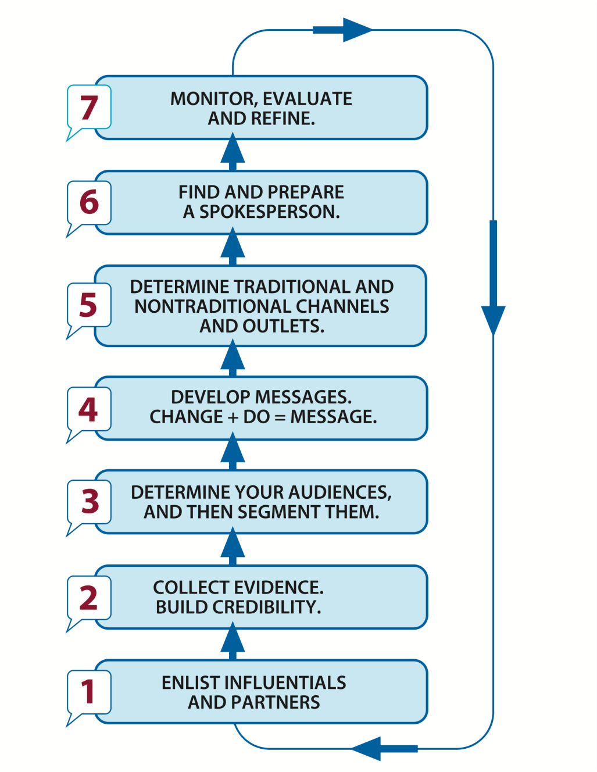
Building Blocks of Advocacy
45

Slide 58
Recap
46

Slide 59
Building Blocks of Advocacy
47

Slide 60
Thank You
48

